Slide 1
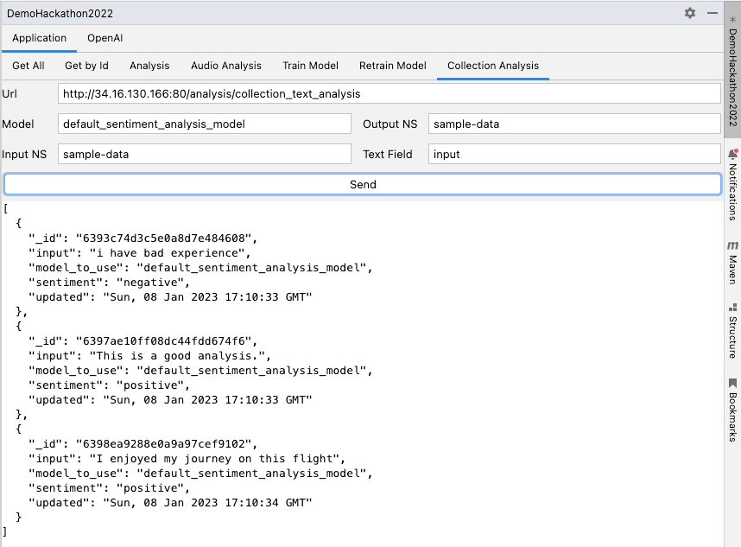
ML Platform on MongoDB Atlas
Presented By:
Desh Bandhu Aggarwal & Mohit Talniya

Slide 2
Problem Statement
MongoDB Atlas does not provide any in-built AI/ML capabilities
Limitations
MongoDB customers are forced to move out application data on other platforms like BigQuery, Amazon SageMaker and Azure ML
Application Challenges & Impact
Additional operational cost
Problems in application management
Application data security
Delay in functional deliveries

Slide 3
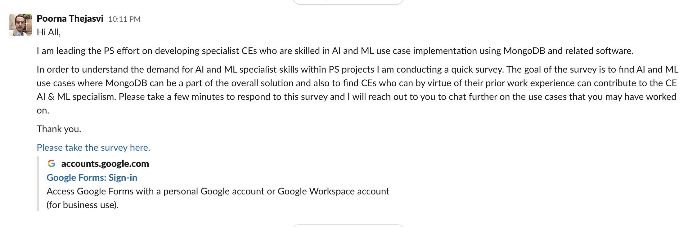
MongoDB Survey
Survey conducted by MongoDB to understand the integration (use cases) of AI & ML with MongoDB

Slide 4
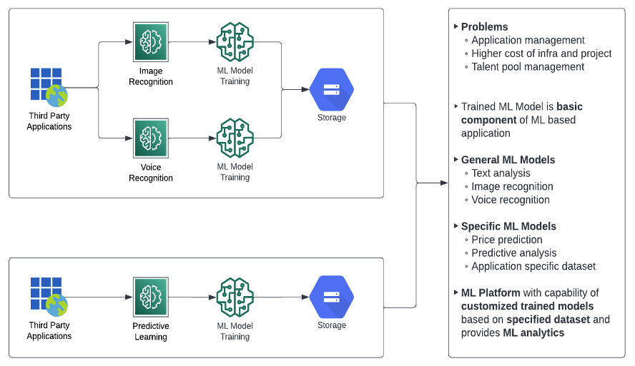
ML Workflow (Example)

Slide 5
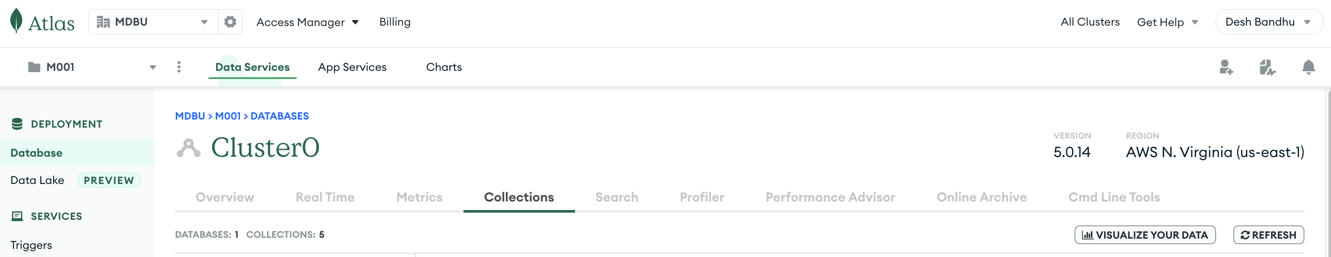
Solution
Integration of AI/ML solutions with MongoDB
Provide AI/ML capabilities on MongoDB Atlas in the form of ML platform and marketplace
MongoAI

Slide 6
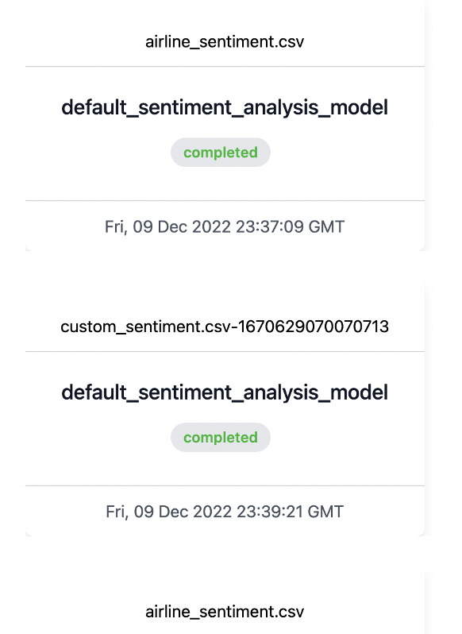
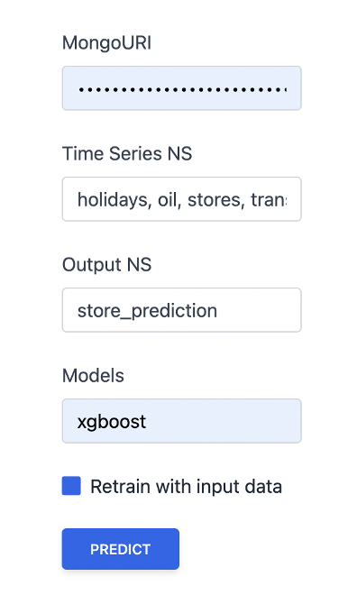
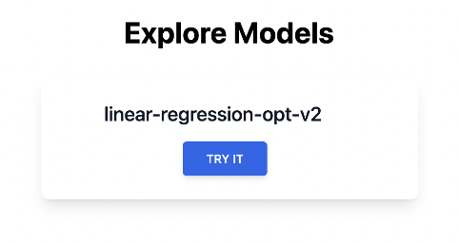
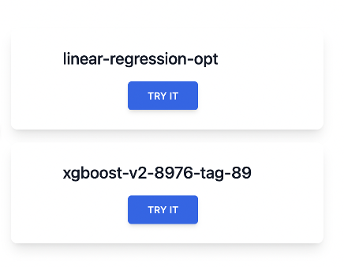
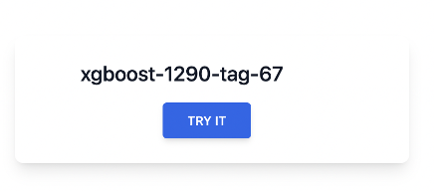
Solution Approach
ML Analysis on the given fields of an input collection and store the results in output collection
Capability to train/re-train ML models and store them at MongoDB.

Slide 7
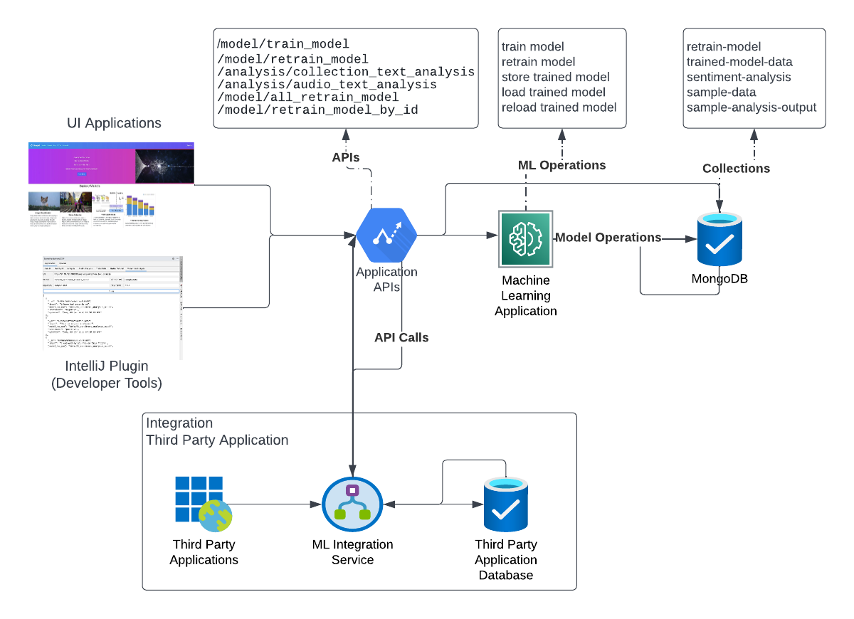
Project Architecture

Slide 8
Demo

Slide 9
Project GitHub Repositories
https://github.com/ms143desh/Hackathon2022
https://github.com/SuperMohit/mongo-ai-ui
Project Bolgs
https://mohit-talniya.hashnode.dev/a-case-for-ml-platform-on-mdb-atlas-part-1
https://medium.com/@ms143desh/integrating-ml-solutions-with-mongodb-30a846a626db

Slide 10
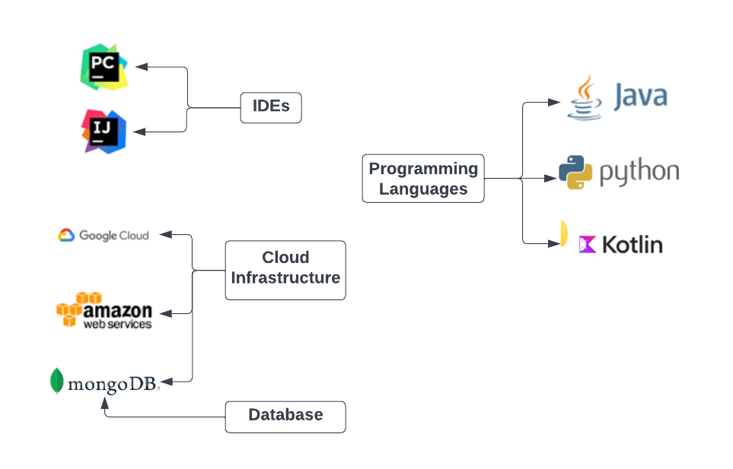
Development Components

